Slide 1
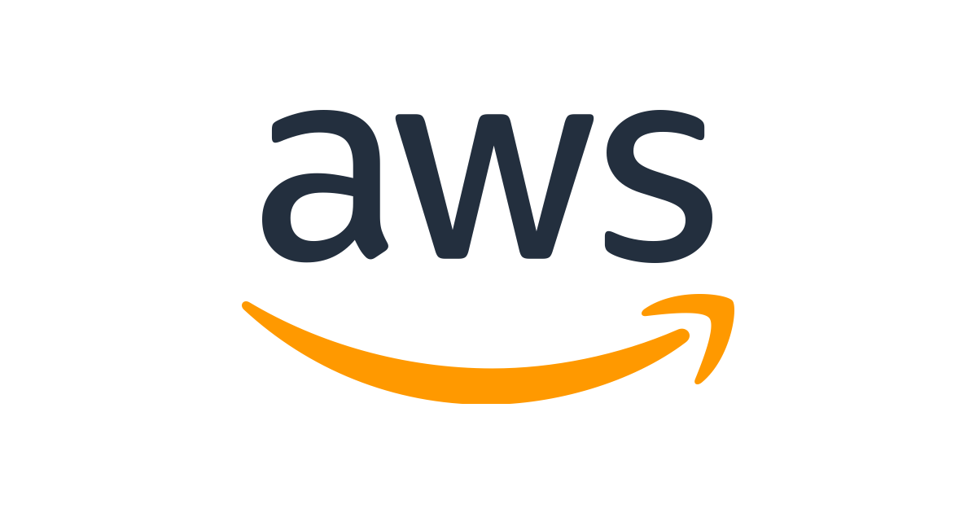
AWS OVERVIEW

Slide 2
AWS PLATFORM - PRODUCTS
AWS Global Infrastructure
Compute
Storage
Network & Content Delivery
Developer Tools
Machine Learning
Databases
Analytics
Robotics
Security, Identity & Compliance
Mobile
Satellite
Migration & Transfer
Business Application
AR & VR
Desktop & App Streaming
Customer Engagement
Blockchain
Management & Governance
Application Integration
IOT
AWS Cost Management
Media Services
Game Development
Legend
Relevant
Non-Relevant

Slide 3

AWS PRODUCTS – COMPUTE
Product | Deployment Unit | You can use it to
Amazon EC2 (Elastic Cloud Compute) | Virtual Machine (VM) | Run any application. Control and manage server or cluster level functions such as scaling and deployment.
Amazon LightSail | Virtual Private Server (Instance) | Run simple applications and websites on one or a few servers for a low, predictable price.
Amazon ECS (Elastic Container Service) | Containers | Run stateless or stateful applications packaged as Docker containers
AWS Lambda | Code | Run event-initiated, stateless applications that need quick response times
https://aws.amazon.com/products/compute/

Slide 4
AWS PRODUCTS – STORAGE
Product | You can use it for
Amazon EBS (Elastic Block Store) | Persistent local storage for Amazon EC2, for relational and NoSQL databases, data warehousing, enterprise applications, Big Data processing, or backup and recovery
Amazon EFS (Elastic File System) | A simple, scalable, elastic file system for Linux-based workloads for use with AWS Cloud services and on-premises resources.
Amazon FSx for Lustre | A fully managed file system that is optimized for compute-intensive workloads, such as high performance computing, machine learning, and media data processing workflows, and is seamlessly integrated with Amazon S3
Amazon FSx for Windows | A fully managed native Microsoft Windows file system built on Windows Server so you can easily move your Windows-based applications that require file storage to AWS
Amazon S3 (Simple Storage Service) | A scalable, durable platform to make data accessible from any Internet location, for user-generated content, active archive, serverless computing, Big Data storage or backup and recovery
Amazon Glacier | Highly affordable long-term storage that can replace tape for archive and regulatory compliance
AWS Storage Gateway | A hybrid storage cloud augmenting your on-premises environment with Amazon cloud storage, for bursting, tiering or migration
Cloud Data Migration Services | A portfolio of services to help simplify and accelerate moving data of all types and sizes into and out of the AWS cloud
AWS Backup | A fully managed backup service that makes it easy to centralize and automate the back up of data across AWS services in the cloud as well as on premises using the AWS Storage Gateway.
https://aws.amazon.com/products/storage/

Slide 5
AWS PRODUCTS – NETWORK & CONTENT DELIVERY
Product | Product Type | You can use it for
Amazon CloudFront | Content Delivery Network (CDN) | Highly secure global CDN to get content to your viewers with low latency and high transfer speeds
Amazon VPC | Virtual Private Cloud | Isolate cloud resources with your own private virtual network
AWS Direct Connect | Dedicated Network Connections to AWS | Dedicated network connection between your network and your Amazon VPC
Elastic Load Balancing | Load Balancing | Automatically distribute application traffic across multiple Amazon EC2 instances in the cloud
Amazon Route 53 | Domain Name Service (DNS) | Highly available and scalable cloud DNS to connect user requests to your AWS resources
https://aws.amazon.com/products/networking/

Slide 6
AWS PRODUCTS – DATABASES
Product | Product Type | You can use it for
Amazon RDS (MySQL, PostgreSQL, MariaDB, Oracle, SQL Server) | Relational Database | Traditional applications, ERP, CRM, and e-commerce.
Amazon Redshift | Warehouse | Data Warehousing, Data Lakes
Amazon DynamoDB | Key-Value | Internet-scale applications, real-time bidding, shopping carts, and customer preferences.
Amazon DocumentDB | Document | Content management, personalization, and mobile applications.
Amazon ElastiCache (Redis, Memcached) | In-Memory | Caching, gaming leaderboards, and real-time analytics.
Amazon Neptune | Graph | Fraud detection, social networking, and recommendation engines
Amazon Timestream | Time Series | IoT applications, DevOps, and industrial telemetry.
Amazon Quantum Ledger Database (QLDB) | Ledger | Systems of record, supply chain, registrations, and banking transactions.
https://aws.amazon.com/products/databases/

Slide 7
AWS PRODUCTS – SECURITY (SELECTED)
Product | Product Type | You can use it for
AWS Certificate Manager | SSL/TLS Certificates | AWS Certificate Manager is a service that lets you easily provision, manage, and deploy Secure Sockets Layer/Transport Layer Security (SSL/TLS) certificates.
AWS Directory Service | Directory | AWS Directory Service for Microsoft Active Directory (Enterprise Edition).
AWS Identity and Access Management (IAM) | Access Control | Use AWS Identity and Access Management (IAM) to control users' access to AWS services. Create and manage users and groups, and grant or deny access.
AWS Organizations | Multiple Account Management | AWS Organizations offers policy-based management for multiple AWS accounts. With Organizations, you can create groups of accounts and then apply policies to those groups.
AWS Single Sign-On | Single Sign-On (SSO) | AWS Single Sign-On (SSO) is a cloud SSO service that makes it easy to centrally manage SSO access to multiple AWS accounts and business applications.
AWS Key Management Service | Key Storage & Management | AWS Key Management Service (KMS) is a managed service that makes it easy for you to create and control the encryption keys used to encrypt your data.
AWS Shield | DDoS Protection | AWS Shield is a managed Distributed Denial of Service (DDoS) protection service that safeguards web applications running on AWS.
xx

Slide 8
AWS PRODUCTS – MANAGEMENT TOOLS
Product | You can use it to
Amazon CloudWatch | Monitor resources and applications
AWS Systems Manager | Gain operational insights and take action on AWS resources
AWS CloudTrail | Track user activity and API usage
AWS Config | Track resource inventory and changes
AWS OpsWorks | Automate operations with Chef and Puppet
AWS Trusted Advisor | Optimize performance and security
xx

Slide 9
AWS PRODUCTS – APPLICATION SERVICES (SELECTED)
Product | Product Type | You can use it for
Amazon Simple Queue Service (SQS) | Managed Message Queues | Amazon Simple Queue Service (SQS) is a fully managed message queuing service that enables you to decouple and scale microservices, distributed systems, and serverless applications
Amazon Simple Notification Service (SNS) | Mobile Push and SMS | Amazon Simple Notification Service (SNS) is a highly available, durable, secure, fully managed pub/sub messaging service that enables you to decouple microservices, distributed systems, and serverless applications.
Amazon Simple Email Service (SES) | Email Sending & Receiving | Amazon Simple Email Service (Amazon SES) is a cloud-based email sending service designed to help digital marketers and application developers send marketing, notification, and transactional emails.
xx

Slide 10

DON’T WORRY, IT WILL BE FINE

Slide 11
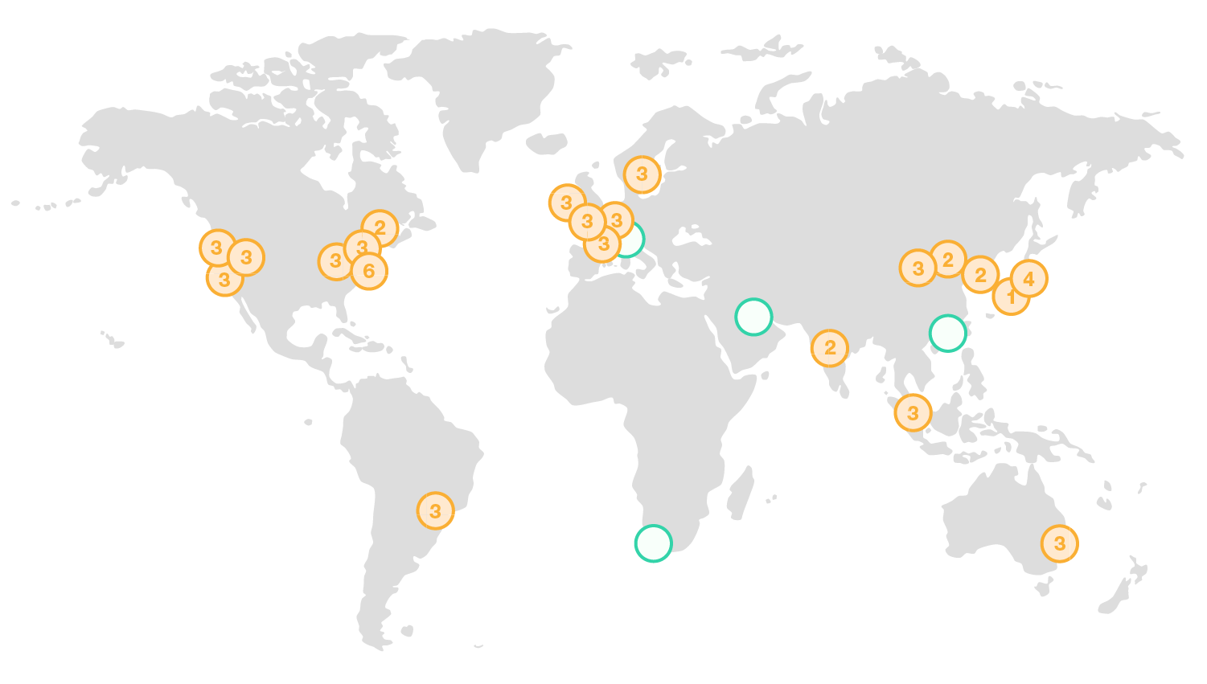


AWS GLOBAL INFRASTRUCTURE
Regions & Availability Zone
New Region (Coming Soon)
20 Geographic Regions
& 1 Local Region
60 Availability Zones (AZs)
12 More AZs Planned
45+ Edge Locations
https://aws.amazon.com/about-aws/global-infrastructure/

Slide 12
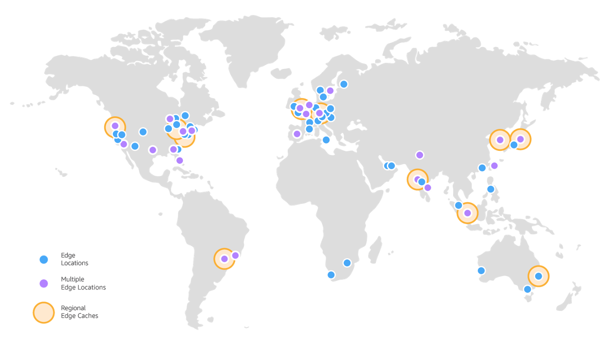
AWS PLATFORM – AVAILABILITY ZONE, REGION & EDGE
A data center has servers, storage, and network equipment racked and stacked together.
DC
DC
One AZ may have more than one Data center.
Availability Zone (AZ)
If multiple DCs are in close proximity they can go down simultaneously
Region
Edge Locations
CloudFront & CDN
AZ-A
AZ-B
Global network of 160 Edges
Spread across 65 cities in 29 countries
AZ-C
A Region is collection of two or more AZs
Regions are distinct geographical area

Slide 13
LAB 1 – Create a WordPress Website in 5 minutes
Login to the AWS Console
Create a VM
Go to EC2 console
Click “Launch Instance”
Choose AMI
Go to “AWS Marketplace”
Search for “WordPress by Bitnami”
Scroll to find “WordPress with NGINX and SSL Certified by Bitnami”, click “Select”
Click on “Continue”
Choose Instance Type
Select t2.micro, ensure a “Free tier eligible” tag is present below the name
Click on “Next: Configure Instance Details”
Configure Instance
Leave the defaults and click on “Next: Add Storage”
Add Storage
Leave the defaults
Click on “Next: Add Tags”
Add Tag
Click on Add Tag
Enter a Name and a Tag
Click on “Next: Configure Security Group”
Configure Security Group
Check “Create a new security group”
Add Rules for SSH, HTTP and HTTPS
Change the Name and description to “MyWebDMZ”
Hit Review and Launch
Explore the Instance Details
Check the “Status Checks”
Explore the Description
Explore the Monitoring
Explore “Tag”
Open the website by pasting the Public IP in the browser
Login to the admin panel
Create a post
View the post
SSH into the VM

